Slide 1

What should a Digital Preservation Technical Registry look like?
Modelling file formats and technical environments using the NSLA Digital Preservation Technical Registry (DPTR) iPres Workshop Melbourne, 7 October 2014
Steve.knight@dia.govt.nz

Slide 2
Some history
March 2010 – NLNZ goes live with Rosetta including Format Library functionality
2011 – NLNZ draft document on elements of a ‘Next generation DPS Technical Library. While describing an ideal Technical Registry it is still a reasonably fully featured view of what a technical registry should comprise and how it should work.
Key components include:
Core principles
Application Library
Format Library
Risk Library
Classification Library
Plugin catalogue
Rules Catalogue
Preservation Plan Catalogue
Event catalogue
Catalogue Manager
Association Manager
Reporting/Data Broker
Editor/Syncer
Binder/Remapper
Audit/Repository
Tools management.

Slide 3
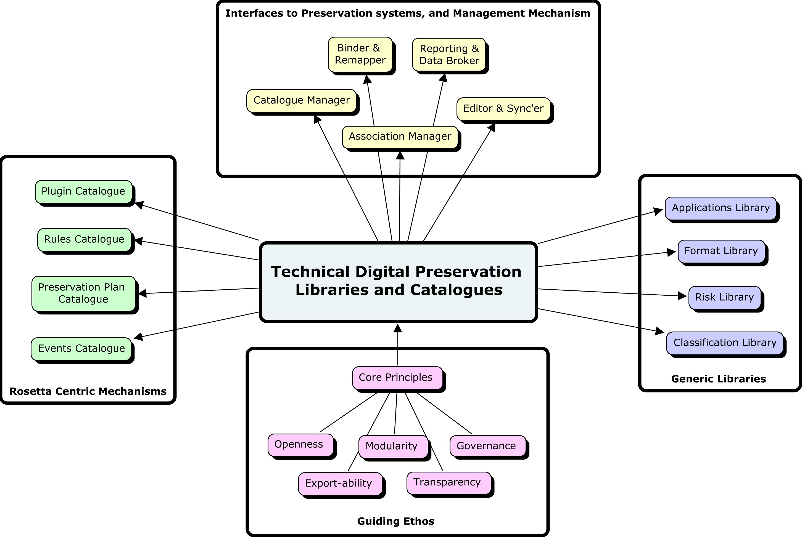
A little more history
The elements of a technical registry were categorised in that paper as follows.

Slide 4
NSLA - Digital Preservation Technical Registry
Timeline
June 2012 – National & State Libraries Australasia (NSLA) Digital Preservation Working Group inaugurated
July 2012 – funding to develop requirements for a Digital Preservation Technical Registry approved by NSLA
October 2012 – iPres Toronto, notion of a KAR discussed
March 2013 – funding to complete requirements and data modelling approved by NSLA
March 2013 – Kanohi ki te kanohi
August 2013 – core documentation completed
October 2013 – market scan exercise with representative vendors (system integrators, small to medium development shops, Ex Libris and Preservica)
February 2014 – business case presented to NSLA CEs

Slide 5
NSLA - Digital Preservation Technical Registry
Partners
National Library of New Zealand
National Library of Australia – knowledge base for format and environmental metadata, and mediapedia for the physical identification of various media carrier types
National Archives and Records Administration – knowledge base on format and environmental metadata
University of Portsmouth – Totem database for environment metadata, deliverable of the European Commission KEEP Project
Archives New Zealand

Slide 6
NSLA DPTR core documents
Represent our understanding at a point in time:
Vision document
Logical Data Model
Data Dictionary
System Actor Descriptions and Use Case Outlines
Quality Attributes
Combined User Stories
Draft Solution Architecture Document

Slide 7
NSLA DPTR key principles, features and characteristics
Open technology
Vendor agnostic
Enterprise class, scaleable technology
A single source of information
Ability to provide data to ANY digital preservation repository (Rosetta, SDB, FEDORA, Duraspace, Archivematica, and so on)
A rich user interface
Enhancements and new versions of software keep pace with user and market demand
Intellectual Property is shared and open and contributes to the development of the registry.

Slide 8
Today’s discussion
Understanding the technical form of the content we are tasked with preserving
Describing a new format model, which we would argue is the most radical component of the proposed Digital Preservation Technical Registry
Building on PRONOM, DROID GDFR, UDFR, TRID etc
Predicated on real-world business as usual experience of the partners and ALL the other organisations spoken to as part of the socialisation process for the Registry

Slide 9
Now on to the real stuff:
Kevin de Vorsey (NARA)
Peter Mckinney (NLNZ)
Jan Hutař (ANZ)
Jay Gattuso (NLNZ)
And the non-playing reserves for today are:
Dave Pearson (NLA)
Libor Coufal (NLA)
David Anderson (UoP
Janet Delve (UoP)
Ross Spencer

